Slide 1
Introduction to
Information theory
A.J. Han Vinck
University of Essen
April 2008

Slide 2
content
Introduction
  Entropy and some related properties
Source coding
Channel coding

Slide 3
First lecture
What is information theory about
Entropy or shortest average presentation length
Some properties of entropy
Mutual information
Data processing theorem
Fano inequality

Slide 4

Field of Interest
Information theory deals with the problem of
efficient and reliable transmission of information
It specifically encompasses theoretical and applied aspects of
- coding, communications and communications networks
- complexity and cryptography
- detection and estimation
- learning, Shannon theory, and stochastic processes

Slide 5
Some of the successes of IT
Satellite communications:
  Reed Solomon Codes (also CD-Player)
Viterbi Algorithm
Public Key Cryptosystems (Diffie-Hellman)
Compression Algorithms
  Huffman, Lempel-Ziv, MP3, JPEG,MPEG
Modem Design with Coded Modulation ( Ungerböck )
Codes for Recording ( CD, DVD )

Slide 6
OUR Definition of Information
Information is knowledge that can be used
i.e. data is not necessarily information
we:
1) specify a set of messages of interest to a receiver
2) and select a message to be transmitted
3) sender and receiver build a pair

Slide 7
Communication model
Analogue to digital conversion
source
digital
compression/reduction
error protection
security
from bit to signal

Slide 8
A generator of messages: the discrete source
Output x ∈ { finite set of messages}
source X
Example:
binary source: x ∈ { 0, 1 } with P( x = 0 ) = p; P( x = 1 ) = 1 - p
M-ary source: x ∈ {1,2, •••, M} with ΣP_{i} =1.

Slide 9
Express everything in bits: 0 and 1
Discrete finite ensemble:
a,b,c,d ⇒ 00, 01, 10, 11
in general: k binary digits specify 2^{k} messages
M messages need ⎡log₂M⎤ bits
Analogue signal: (problem is sampling speed)
1) sample and 2) represent sample value binary
11
10
01
00
v
Output
00, 10, 01, 01, 11
t

Slide 10
The entropy of a source a fundamental quantity in Information theory
entropy
The minimum average number of binary digits needed
to
specify a source output (message) uniquely is called
“SOURCE ENTROPY”

Slide 11
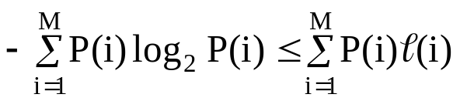
SHANNON (1948):
1) Source entropy:= = L
2) minimum can be obtained !
QUESTION: how to represent a source output in digital form?
QUESTION: what is the source entropy of text, music, pictures?
QUESTION: are there algorithms that achieve this entropy?

Slide 12
Properties of entropy
A: For a source X with M different outputs: log₂M ≥ H(X) ≥ 0
the „worst“ we can do is
just assign log₂M bits to each source output
B: For a source X „related“ to a source Y: H(X) ≥ H(X|Y)
Y gives additional info about X
when X and Y are independent, H(X) = H(X|Y)

Slide 13
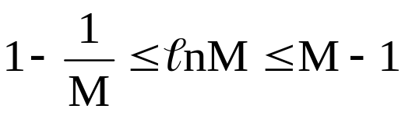
Entropy: Proof of A
We use the following important inequalities
log₂M = lnM log₂e
M-1 lnM
1-1/M
M
Homework: draw the inequality

Slide 14
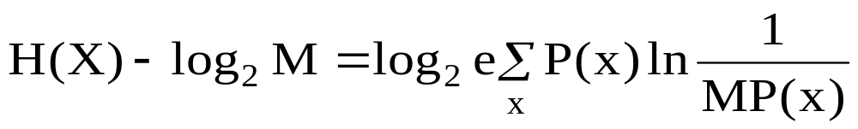
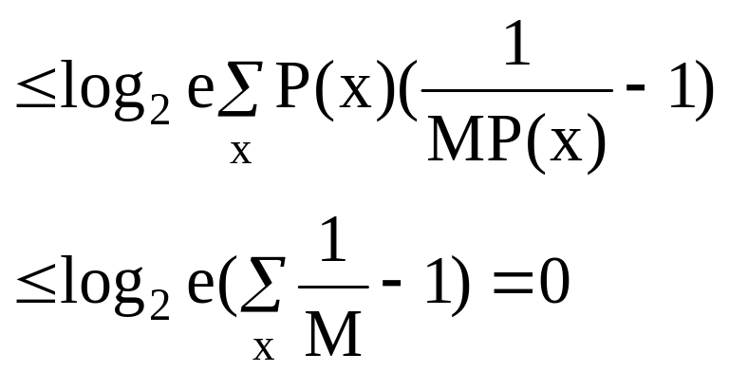
Entropy: Proof of A

Slide 15
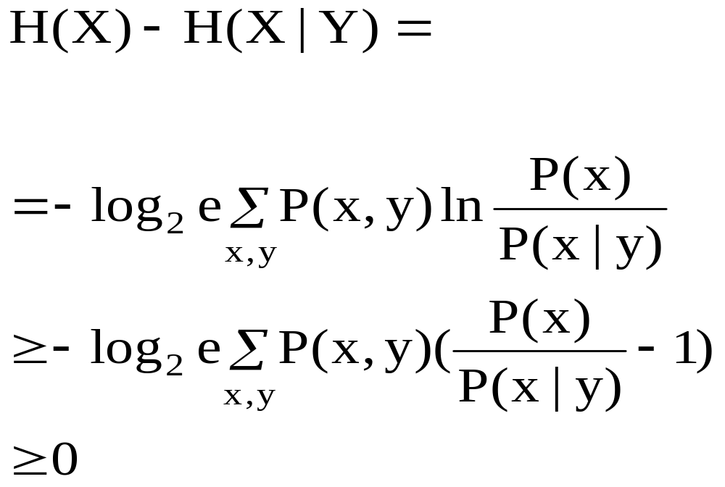
Entropy: Proof of B

Slide 16
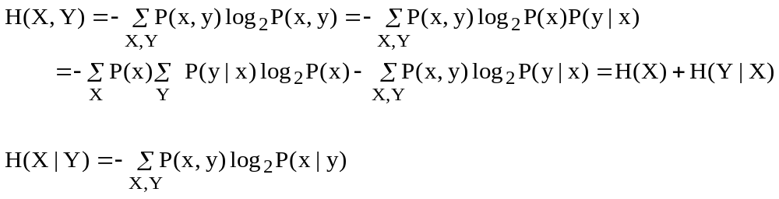
Joint Entropy: H(X,Y) = H(X) + H(Y|X)
also H(X,Y) = H(Y) + H(X|Y)
  intuition: first describe Y and then X given Y
  from this: H(X) – H(X|Y) = H(Y) – H(Y|X)
As a formel:
Homework: check the formel

Slide 17
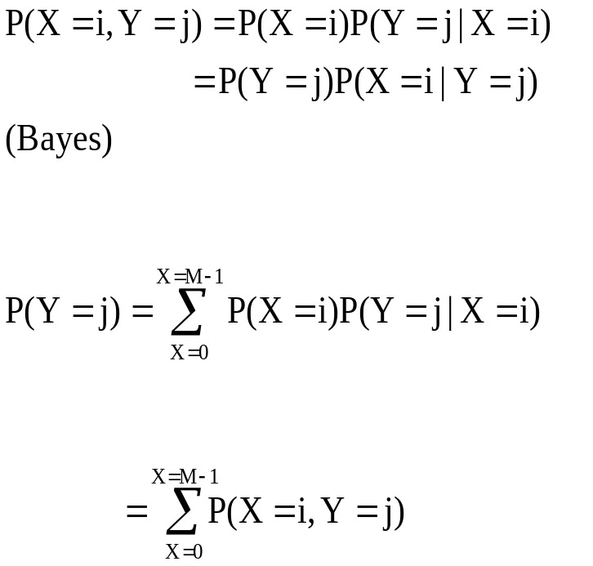
The connection between X and Y
X Y
P(X=0) Y = 0
P(X=1) Y = 1
••• •••
P(X=M-1) Y = N-1
P(Y=0|X=0)
P(Y= N-1|X=1)
P(Y=1|X=M-1)
P(Y=0|X=M-1)
P(Y= N-1|X=0)
P(Y= N-1|X=M-1)

Slide 18
Entropy: corrolary
H(X,Y) = H(X) + H(Y|X)
= H(Y) + H(X|Y)
H(X,Y,Z) = H(X) + H(Y|X) + H(Z|XY)
≤ H(X) + H(Y) + H(Z)

Slide 19
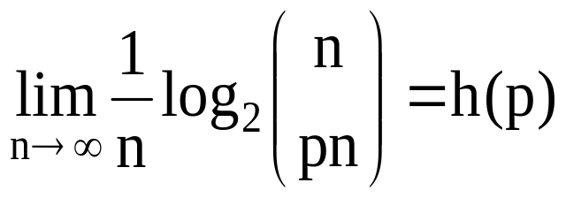
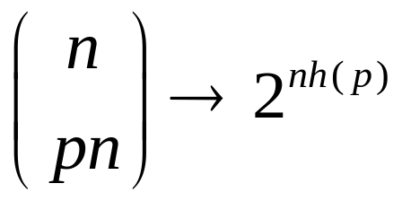

Binary entropy
interpretation:
let a binary sequence contain pn ones, then we can specify each sequence with
log₂ 2^{nh(p)} = n h(p) bits
Homework: Prove the approximation using ln N! ~ N lnN for N large.
Use also log_{a}x = y → log_{b} x = y log_{b}a
The Stirling approximation →

Slide 20
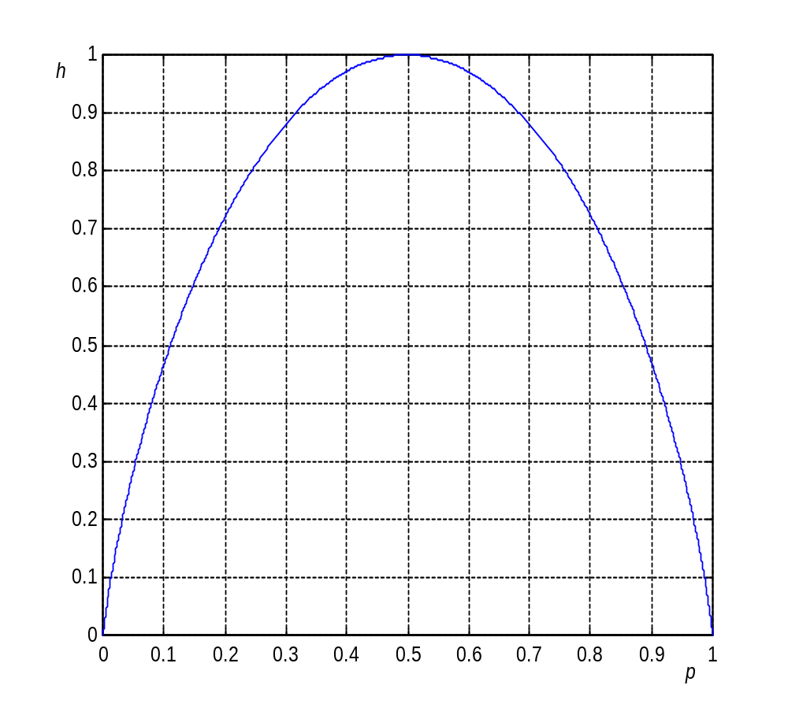
The Binary Entropy: h(p) = -plog₂p – (1-p) log₂ (1-p)
Note:
h(p) = h(1-p)

Slide 21
homework
Consider the following figure
Y
0 1 2 3 X
All points are equally likely. Calculate H(X), H(X|Y) and H(X,Y)
3
2
1

Slide 22
Source coding
Two principles:
data reduction: remove irrelevant data (lossy, gives errors)
data compression: present data in compact (short) way (lossless)
original
data
Relevant data
remove
irrelevance
compact
description
Transmitter side
„original data“
„unpack“
receiver side

Slide 23
Shannons (1948) definition of transmission of information:
Reproducing at one point (in time or space) either exactly or approximatelya message selected at another point
Shannon uses: Binary Information digiTS (BITS) 0 or 1
n bits specify M = 2^{n} different messages
OR
M messages specified by n = ⎡ log₂ M⎤ bits

Slide 24
Example:
fixed length representation
00000 ← a • • • 11001 ← y
00001 ← b 11010 ← z
- the alphabet: 26 letters, → ⎡log₂ 26⎤ = 5 bits
- ASCII: 7 bits represents 128 characters

Slide 25
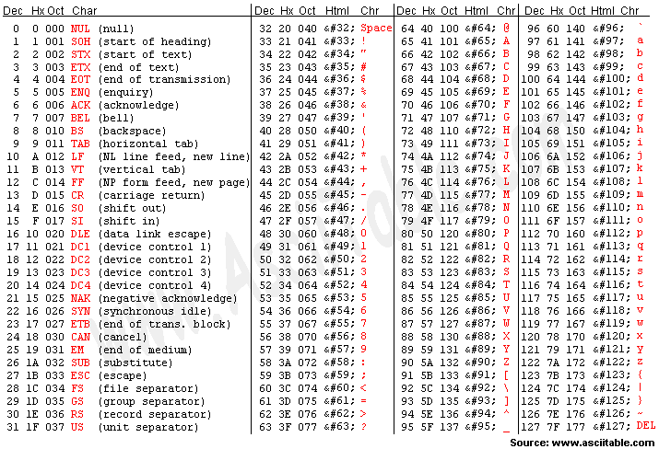
ASCII Table to transform our letters and signs into binary ( 7 bits = 128 messages)
ASCII stands for American Standard Code for Information Interchange

Slide 26

Example:
suppose we have a dictionary with 30.000 words
these can be numbered (encoded) with 15 bits
if the average word length is 5, we need „on the average“ 3 bits per letter
01000100 • • •

Slide 27
another example
Source output a,b, or c translate output
binary
In out
In out
a 00
b 01
c 10
aaa 00000
aab 00001
aba 00010
•••
ccc 11010
improve
efficiency
improve
efficiency ?
Efficiency = 2 bits/output symbol
Efficiency = 5/3 bits/output symbol
Homework: calculate optimum efficiency

Slide 28
Source coding (Morse idea)
Example: A system generates
the symbols X, Y, Z, T
with probability P(X) = ½; P(Y) = ¼; P(Z) = P(T) = 1/8
Source encoder: X ⇒ 0; Y ⇒ 10; Z ⇒ 110; T = 111
Average transm. length = ½ x 1 + ¼ x 2 +2 x 1/8 x 3 = 1¾ bit/s.
A naive approach gives X ⇒ 00; Y ⇒ 10; Z ⇒ 11; T = 01
With average transm. length 2 bit/s.

Slide 29
Example: variable length representation of messages
C1 C2 letter frequency of occurence P(*)
00 1 e 0.5
01 01 a 0.25
10 000 x 0.125
11 001 q 0.125
0111001101000…
aeeqea…
Note: C2 is uniquely decodable! (check!)

Slide 30
Efficiency of C₁ and C₂
  Average number of coding symbols of C₁
  Average number of coding symbols of C₂
C₂ is more efficient than C₁

Slide 31
Source coding theorem
Shannon shows that source coding algorithms exist that have a
  Unique average representation length that approaches the entropy of the source
  We cannot do with less

Slide 32
Basic idea cryptography
send
message
operation
cryptogram
open
secret
closed
receive
cryptogram
operation
message
closed
secret
open

Slide 33
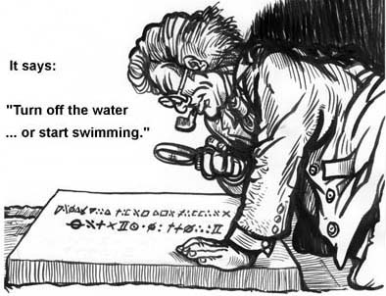
example

Slide 34
Source coding in Message encryption (1)
Part 1
Part 2 •••
Part n (for example every part 56 bits)
dependancy exists between parts of the message
•••
encypher
key
•••
n cryptograms,
dependancy exists between cryptograms
•••
decypher
Attacker:
n cryptograms to analyze for particular message of n parts
key
Part 1
Part 2
Part n

Slide 35
Source coding in Message encryption (2)
Part 1
Part 2 •••
Part n
(for example every part 56 bits)
n-to-1
source encode
Attacker:
- 1 cryptogram to analyze for particular message of n parts
- assume data compression factor n-to-1
Hence, less material for the same message!
key
encypher
1 cryptogram
decypher
Source decode
Part 1
Part 2 •••
Part n

Slide 36
Transmission of information
Mutual information definition
Capacity
Idea of error correction
Information processing
Fano inequality

Slide 37
mutual information I(X;Y):=
I(X;Y) := H(X) – H(X|Y)
= H(Y) – H(Y|X) ( homework: show this! )
i.e. the reduction in the description length of X given Y
note that I(X;Y) ≥ 0
or: the amount of information that Y gives about X
equivalently: I(X;Y|Z) = H(X|Z) – H(X|YZ)
the amount of information that Y gives about X given Z

Slide 38
3 classical channels
Binary symmetric erasure Z-channel
(satellite) (network) (optical)
0
X
1
0
X
1
0
E
1
0
X
1
0
Y
1
0
Y
1
Homework:
find maximum H(X)-H(X|Y) and the corresponding input distribution

Slide 39
Example 1
Suppose that X Є { 000, 001, •••, 111 } with H(X) = 3 bits
Channel: X Y = parity of X
channel
H(X|Y) = 2 bits: we transmitted H(X) – H(X|Y) = 1 bit of information!
We know that X|Y Є { 000, 011, 101, 110 } or X|Y Є { 001, 010, 001, 111 }
Homework: suppose the channel output gives the number of ones in X.
What is then H(X) – H(X|Y)?

Slide 40
Transmission efficiency
Example: Erasure channel
1-e
½
0
1
0
E
1
(1-e)/2
e
e
e
½
(1-e)/2
1-e
H(X) = 1 H(X|Y) = e
H(X)-H(X|Y) = 1-e = maximum!

Slide 41
Example 2
Suppose we have 2^{n} messages specified by n bits
1-e
Transmitted : 0 0
e E
1 1
1-e
After n transmissions we are left with ne erasures
  Thus: number of messages we cannot specify = 2^{ne}
We transmitted n(1-e) bits of information over the channel!

Slide 42
Transmission efficiency
Easy obtainable when feedback!
0,1
0 or 1 received correctly
If Erasure, repeat until correct
0,1,E
erasure
R = 1/ T =1/ Average time to transmit 1 correct bit
= 1/ {(1-e) + 2e(1-e) + 3e²(1-e) + ••• }= 1- e

Slide 43
Transmission efficiency
I need on the average H(X) bits/source output to describe the source symbols X
After observing Y, I need H(X|Y) bits/source output
H(X) H(X|Y)
Reduction in description length is called the transmitted information
  Transmitted R = H(X) - H(X|Y)
  = H(Y) – H(Y|X) from earlier calculations
We can maximize R by changing the input probabilities.
The maximum is called CAPACITY (Shannon 1948)
X
Y
channel

Slide 44
Transmission efficiency
Shannon shows that error correcting codes exist that have
  An efficieny k/n ≤ Capacity
    n channel uses for k information symbols
  Decoding error probability ≈ 0
    when n very large
Problem: how to find these codes

Slide 45
In practice:
Transmit
0 or 1
Receive
0 or 1
What can we do about it ?
0 0 correct
0 1 in - correct
1 1 correct
1 0 in - correct

Slide 46
Reliable: 2 examples
Transmit
A: = 0 0
B: = 1 1
Receive
0 0 or 1 1 OK
0 1 or 1 0 NOK
1 error detected!
A: = 0 0 0
B: = 1 1 1
000, 001, 010, 100 ⇒ A
111, 110, 101, 011 ⇒ B
1 error corrected!

Slide 47
Data processing (1)
Let X, Y and Z form a Markov chain: X → Y → Z
and Z is independent from X given Y
i.e. P(x,y,z) = P(x) P(y|x) P(z|y)
X P(y|x) Y P(z|y) Z
I(X;Y) ≥ I(X; Z)
Conclusion: processing destroys information

Slide 48
Data processing (2)
To show that: I(X;Y) ≥ I(X; Z)
Proof: I(X; (Y,Z) ) =H(Y,Z) - H(Y,Z|X)
=H(Y) + H(Z|Y) - H(Y|X) - H(Z|YX)
= I(X; Y) + I(X; Z|Y)
I(X; (Y,Z) ) = H(X) - H(X|YZ)
= H(X) - H(X|Z) + H(X|Z) - H(X|YZ)
= I(X; Z) + I(X;Y|Z)
now I(X;Z|Y) = 0 (independency)
Thus: I(X; Y) ≥ I(X; Z)

Slide 49
Fano inequality (1)
Suppose we have the following situation: Y is the observation of X
X p(y|x) Y decoder X‘
Y determines a unique estimate X‘:
correct with probability 1-P;
incorrect with probability P

Slide 50
Fano inequality (2)
Since Y uniquely determines X‘, we have H(X|Y) = H(X|(Y,X‘)) ≤ H(X|X‘)
X‘ differs from X with probability P
Thus for L experiments, we can describe X given X‘ by
firstly: describe the positions where X‘ ≠ X with Lh(P) bits
secondly: - the positions where X‘ = X do not need extra bits
- for LP positions we need ≤ log₂(M-1) bits to specify X
Hence, normalized by L: H(X|Y) ≤ H(X|X‘) ≤ h(P) + P log₂(M-1)

Slide 51
Fano inequality (3)
H(X|Y) ≤ h (P) + P log₂(M-1)
log₂M
H(X|Y)
log₂(M-1)
P
0
(M-1)/M
1
Fano relates conditional entropy with the probability of a correct guess

Slide 52
Fano inequality (3): example
X ∈ { 0, 1, 2, 3 }; P ( X = 0, 1, 2, 3 ) = (¼ , ¼ , ¼, ¼ )
X can be observed as Y
Example 1: No observation of X P= ¾; H(X) = 2 ≤ h ( ¾ ) + ¾ log₂3
Example 2:
Example 3:
0 0 transition prob. = 1/3
1 1 H(X|Y) = log₂3
2 2 P > 0.4
3 3
0 0 transition prob. = 1/2
1 1 H(X|Y) = log₂2
2 2 P > 0.2
3 3
x
y
x
y

Slide 53
List decoding
Suppose that the decoder forms a list of size L.
P_{L} is the probability of being in the list
Then
H(X|Y) ≤ h(P_{L} ) + P_{L}log ₂L + (1-P_{L}) log₂ (M-L)
The bound is not very tight, because of log ₂L.
Can you see why?

Slide 54
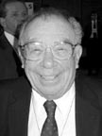
Fano
Shannon showed that it is possible to compress information. He produced examples of such codes which are now known as Shannon-Fano codes.
Robert Fano was an electrical engineer at MIT (the son of G. Fano, the Italian mathematician who pioneered the development of finite geometries and for whom the Fano Plane is named).
Robert Fano

Slide 55
Application source coding: example MP3
Digital audio signals:
Without data reduction,
16 bit samples at a sampling rate 44.1 kHz for Compact Discs. 1.400 Mbit represent just one second of stereo music in CD quality.
With data reduction:
MPEG audio coding, is realized by perceptual coding techniques addressing the perception of sound waves by the human ear. It maintains a sound quality that is significantly better than what you get by just reducing the sampling rate and the resolution of your samples.
Using MPEG audio, one may achieve a typical data reduction of
1:4 | by Layer 1 (corresponds to 384 kbps for a stereo signal),
1:6...1:8 | by Layer 2 (corresponds to 256..192 kbps for a stereo signal),
1:10...1:12 | by Layer 3 (corresponds to 128..112 kbps for a stereo signal),

